Slide 1
Cap Store Application

Slide 2
I.P.S Prakash – 153008 JEE FULL STACK- MIPL

Slide 3
MODULES

Slide 4
Modules Assigned
CapStore Home Page
Product Page
WishList
Similar Products
Notes:
Usar para separador de capitulos . Seria bom ter esta versao em vermelho e verde tb..

Slide 5
Module Owned
Product Page

Slide 6
Softwares Used
• JDK 10
• Spring Boot 2.x
• My SQL 5.x
• SQL Yog 8.5
• Spring Tool Suite 3.9.x
• Spring Boot Data
• Spring Boot Rest Controller
• JSP – Front-end
• Jenkins – Build Server
• Git - Source Code Repository
• Postman

Slide 7
Product Page
Product Image
Product Name
Product Cost
Product Description
Buttons
Wish List
Add to Cart
Buy Now
Discounts
Feedback /Rating
Similar Products

Slide 8
Tables Involved
Inventory
Discounts table
Feed Back Table

Slide 9
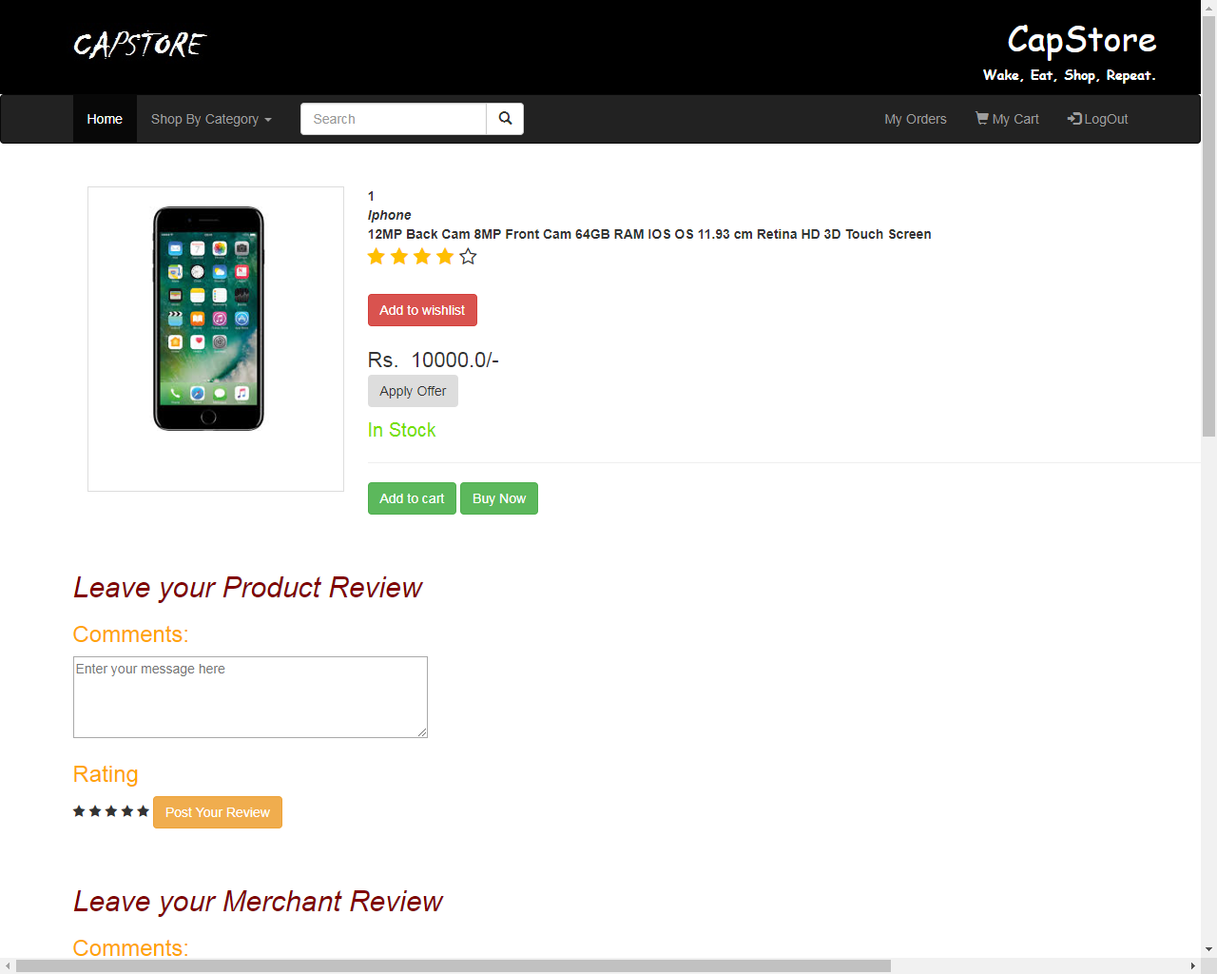

Slide 10
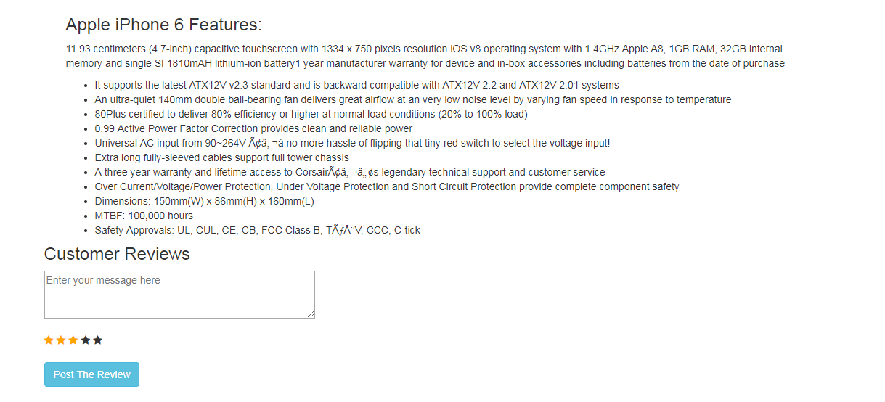

Slide 11
Thank You
Notes:
EVITAR usar o spada branco – tem que ser sempre o colorido.

